Slide 1

Plant Disease Diagnose System
Furqan Ahmad : FA21-BSE-089
Asad Khan : FA21-BSE-081
Abdul Muhaimin : FA21-BSE-061
Supervisor-name: Javed Raza
Department of Computer Science
COMSATS University Islamabad, Abbottabad

Slide 2
Agenda
Project Introduction
Project Scope
Functional Requirements
Non-Functional Requirements
Activity Diagram
Class Diagram
ER Diagram
DF Diagram
Use case Diagram
System Block Diagram
Testcases
Flow chart/ pseudo code/ Algorithm
Gant Chart
Status of Thesis Report
Summary of 60%

Slide 3
Project Introduction
Mobile application for detecting and diagnosing plant diseases
Uses deep learning and image processing techniques
Supports monitoring of multiple plants
Provides detailed disease information and treatment recommendations
Aims to improve plant health management for farmers and agriculturists

Slide 4
Project Scope
Enables disease prediction through plant image uploads (leaf).
Supports user roles: farmers and admins.
Offers disease reports and recommendations.
Offers an app platform and an online-supported mobile app.

Slide 5
Functional Requirements
User Authentication & User Management
Signup/login functionality.
Role-based access control (farmers, admins).
Disease Prediction via Image Upload
Preprocessing and prediction of diseases using a deep learning model.
Plant Health Monitoring
Track multiple plants and their health over time.
Disease Information & Recommendations
A database of plant diseases with treatments and prevention measures.

Slide 6
Non-Functional Requirements
Performance:
The system should deliver accurate results within seconds of image upload.
Usability:
A user-friendly interface, accessible to users of varying technical expertise.
Scalability:
Capable of handling a growing number of users and a large disease database.
Reliability:
Ensure system uptime for critical agricultural operations.
Security:
Protect user data

Slide 7
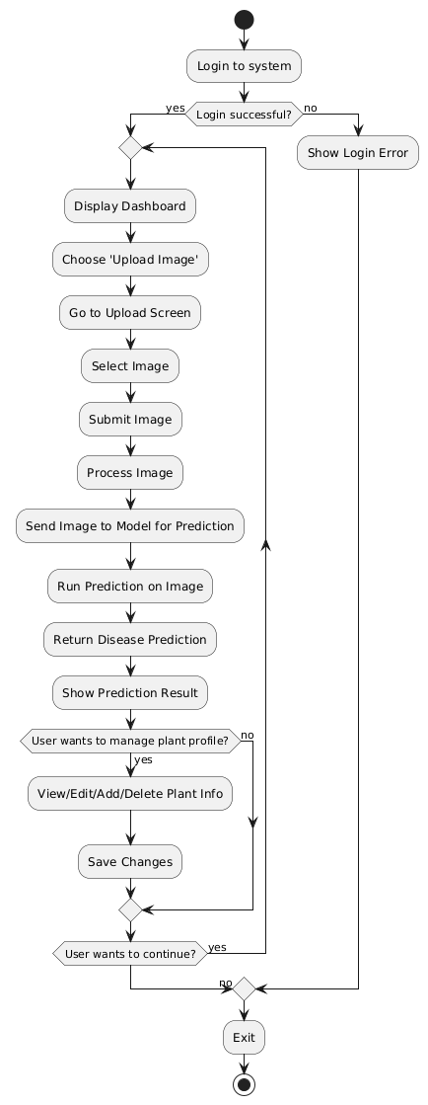
Activity Diagram

Slide 8
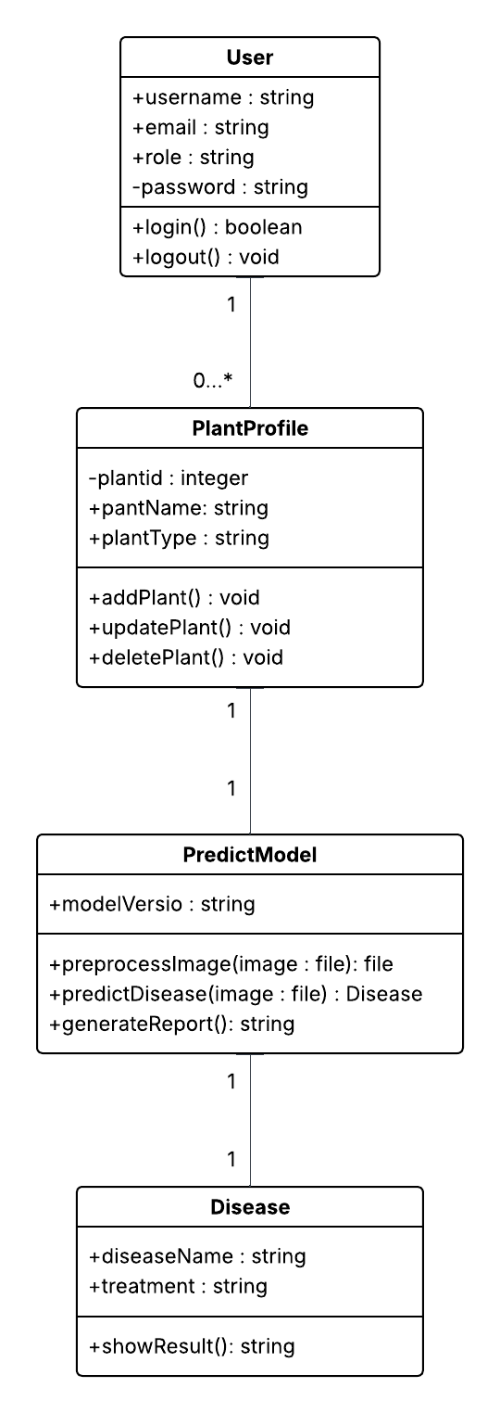
Class Diagram

Slide 9
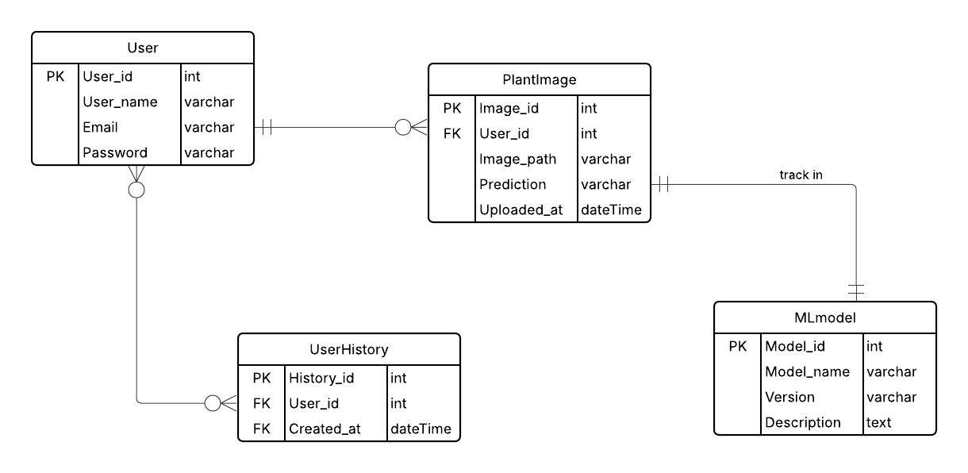
E-R Diagram

Slide 10
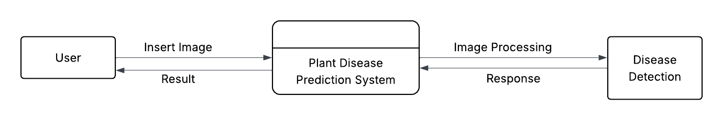
DFD (Structural Approach)
Level 0

Slide 11
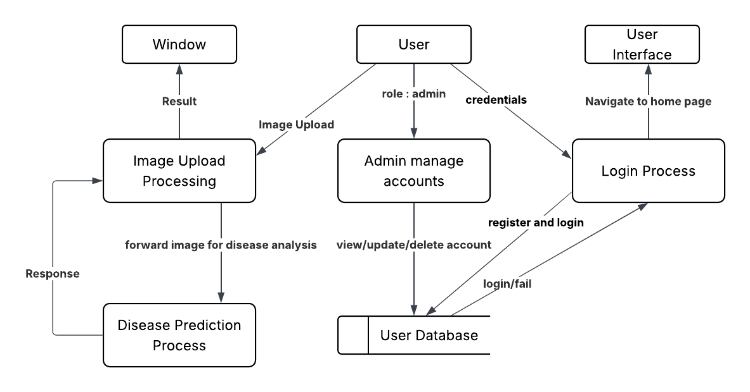
Continue
Level 1

Slide 12
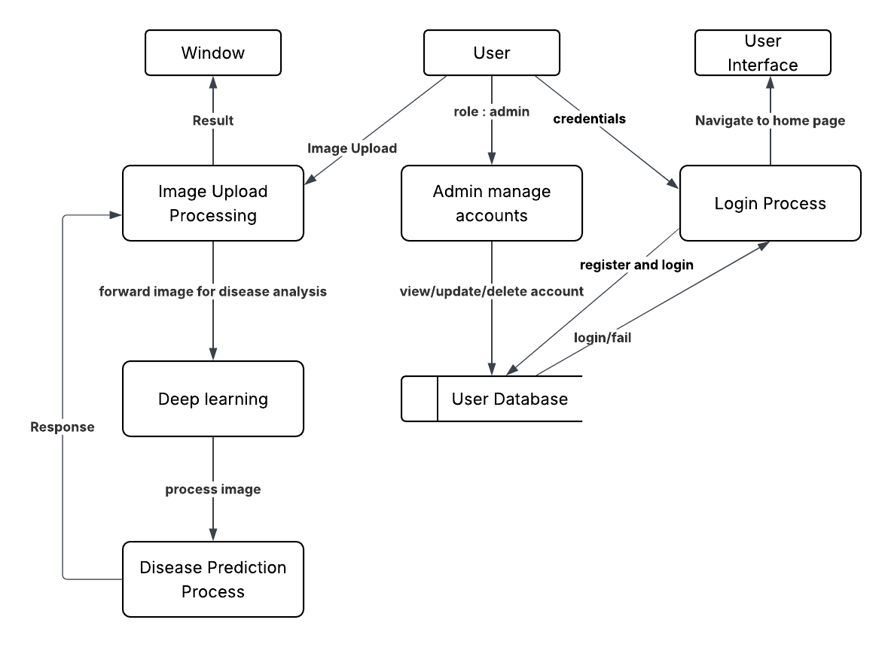
Continue
Level 2

Slide 13
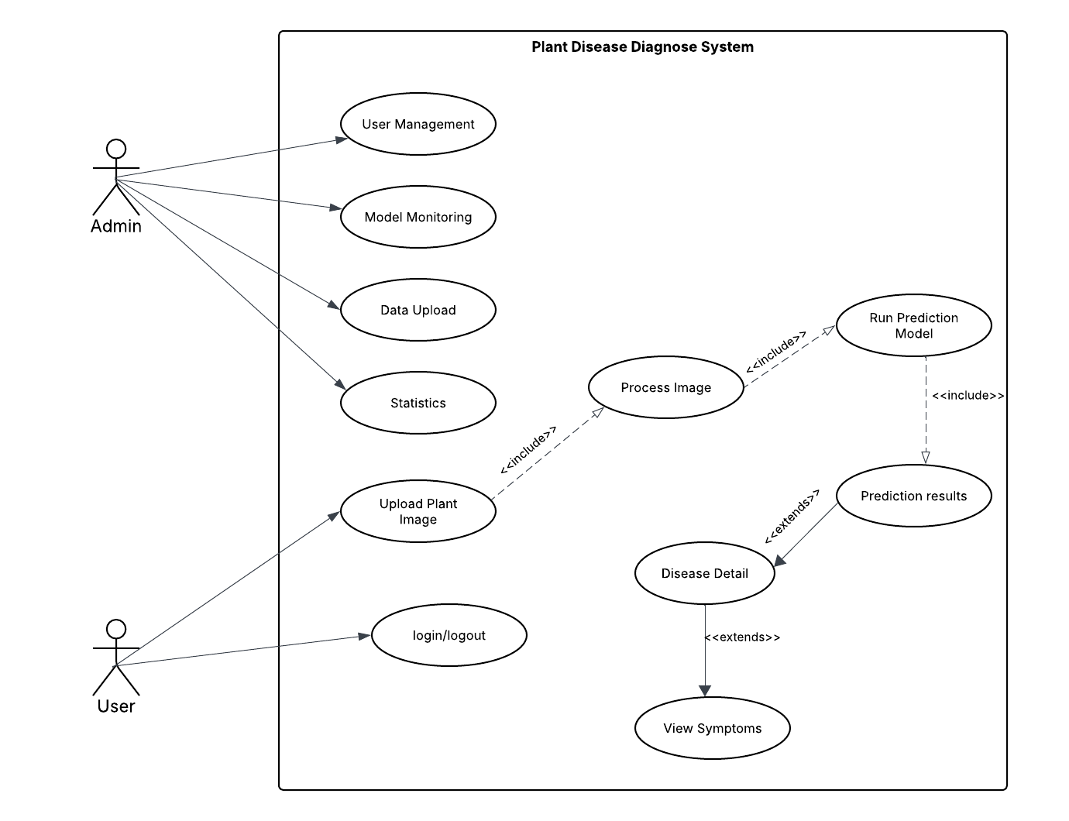
Use Cases Diagram

Slide 14
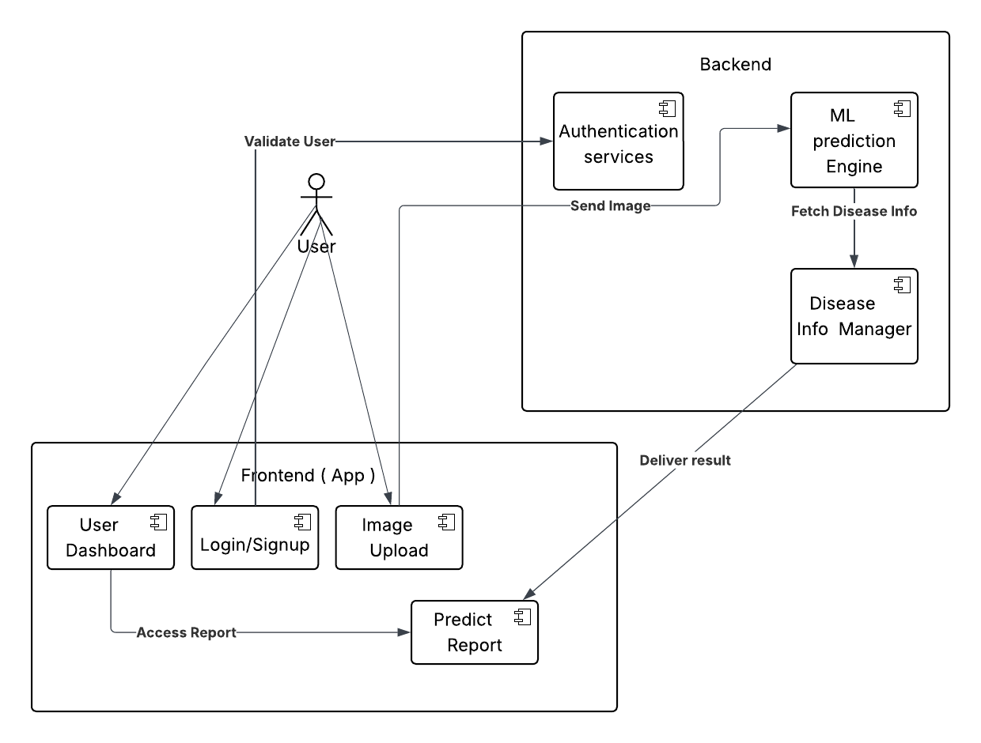
System Block Diagram

Slide 15
Test Cases
Unit Testing (e.g., login, profile delete)
Functional Testing (e.g., image upload)
Integration Testing (e.g., flow from upload to prediction)
Manual Testing (all features)
Automated Testing (using tools like Postman)

Slide 16
Flow chart/ pseudo code/ Algorithm

Slide 17
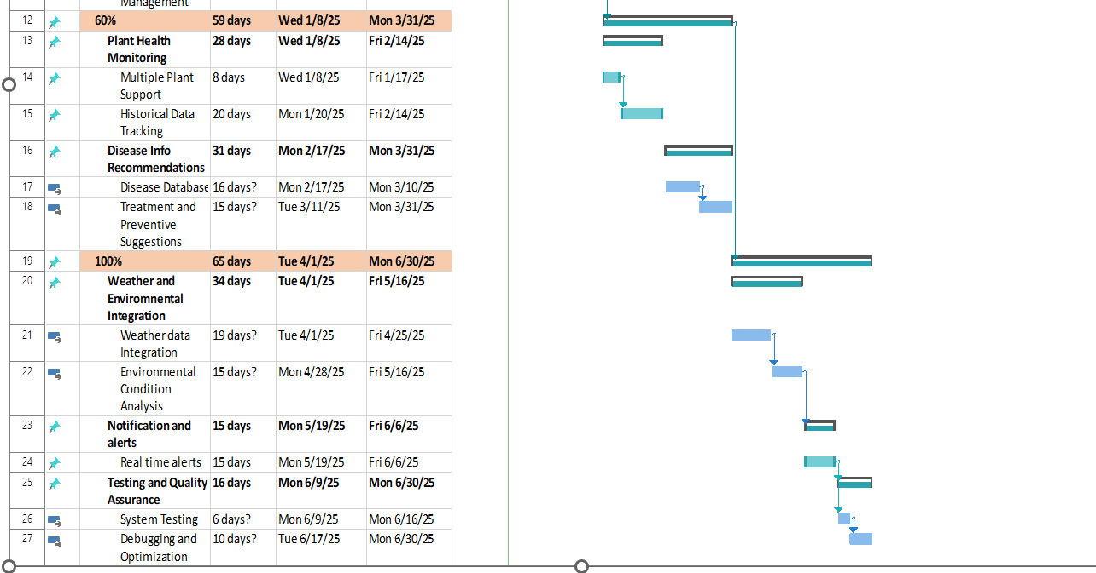
Gantt Chart

Slide 18
Status of Thesis Report
Chapters 1–6 (Introduction to Testing) – Completed
Diagrams (Use Case, Activity, Sequence, Architecture) – Completed
Implementation & Algorithms – Completed
Literature Review – Completed
References – Completed

Slide 19
Summary of 60% Project Implementation
Chapters 1 to 4 completed
Diagrams (Use Case, Activity, Sequence, Class) are added
System architecture and design are done
Literature review is included
HCI design is described

